Slide 1
Welcome to the PPCHS’s Science Club and Science National Honor Society General Meeting!
You are currently earning ½ hour for attending this meeting!
Please Sign In ☺
If you need to submit dues/applications please wait until the end!

Slide 2
Science Day at PPCHS
The science day at PPCHS will take place on November 3rd, 2016!
If you are interested in participating in an activity, please sign up for the science day at the end of the meeting. Please stay today to practice your experiments!
It is mandatory to attend both of the practices if you are participating !
Earn up to 5 club hours by attending practices and doing events!

Slide 3
Markham Park Constellation/Roasting Event
At Markham Park ( this Saturday) at 7:30, we are conducting a constellation viewing and marshmallow roasting event as an Ice Breaker for the club ☺
16001 W State Rd 84, Sunrise, FL 33326

Slide 4
Hope Totes
SM
Donations to various Homeless shelters in Palm Beach County/Daytona Beach/St. Augustine
Donations Requested:
Socks
Toothbrushes
Toothpaste
Dental Floss
Body wash
Hand sanitizer
Disposable Razors
Deodorant
Shaving Cream
Combs/Brushes
Mini/disposable Rain Ponchos
Mini Flashlights
Please Submit donations ( minimum of 6 items listed above) to the Front office for rooms D214 and S201 !
Any and All donations are welcomed by Thursday, October 27th so we can assemble and donate the totes ASAP. 2 hrs for at least 6 items donated!

Slide 5
**Recycling Requirement
All members are required to fulfil the mandatory recycling requirement !
Multiple people may sign up at one time, so it is important that you sign up in the recycling book ahead of time to guarantee your spot !
It is only mandatory for SNHS members/science club members to recycle once a quarter.

Slide 6
Recycling
Every Tuesday, Wednesday, Friday. See Alejandro Pellon and Lilliana Thomas for details.
Mandatory for all members to recycle once every quarter!
**Failure to recycle once a quarter will result in removal from the club.

Slide 7
Tutoring
Thursdays During Homeroom !!
Club hours
Members must make a commitment for tutoring each week !
Members are subject to Probation from SNHS and science club if they sign up for tutoring/recycling and fail to attend without prior notification.

Slide 8
Competitions
All competition groups will meet every other Tuesday during homeroom in S122
1st meeting is next week. SECME/SCIENCE Olympiad- please come prepared with your event and topic selected, as well as your individual guidelines/rubric printed!
Failure to participate will result in “member probation” , which will encourage extra participation on your part and a possible removal from the club for non-participation

Slide 9
Lectures
**September 27th- Sofia Mohammad and Amaya Richmond
November 7th – Lilliana Thomas and Camilo Grijalva
November 22nd –William Kong and Alejandro Pellon
January 24th- TBA
February 21st -TBA
March 28th - TBA
April 18th- TBA
** Members are welcome to do lectures after getting their topics approved! It’s a great way to get hours! ☺
We changed the date to accommodate new members !

Slide 10
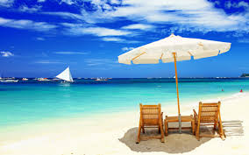
Beach Cleanup 11/12
There will be a beach cleanup November 12th at Hollywood beach from 9am-12pm.
Gloves, trashbags, etc are all provided. Don’t forget to bring water bottles, sunscreen, and some snacks !
At N Broadwalk, Hollywood, FL 33019
Sign up before you go to clean the beach!. You get 4 club hours.

Slide 11
STEM Learning Event
Attend Ten80’s STEM Innovators-in-Training Experience on Wednesday, November 9 at iTech @ Thomas A. Edison Educational Center as an observer or by bringing a minimum of 5 high school students to this team engineering and enterprise event. There is NO cost to attend. Bring 40 or more high school students and the event and long-term learning are fully funded! Choose up to $5,200 in curriculum, materials and training to implement in a new or existing Engineering, Business, STEM, Intro to CS and/or Robotics course or club. Shirt Lunch Included !!
Up to 40 members needed, 6 Club Hours !!
FORMS ARE DUE BY THIS THURSDAY, OR SPOTS WILL BE GIVEN TO OTHER STUDENTS

Slide 13
Remind 101 Texts
Text: 81010
Message: @ppchssnhs

Slide 14
Any Comments,
Questions,
Or Concerns?

Slide 15
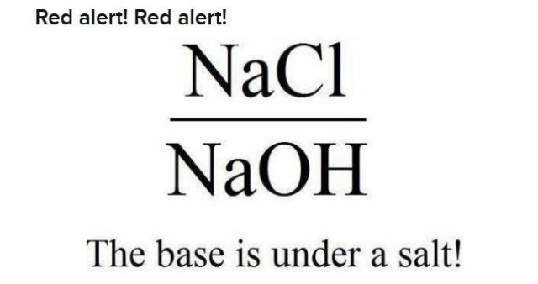
SNHS- Don’t forget to sign in!
Don’t forget to sign up for tutoring, recycling, and mark the date for the next lecture!
STAY FOR SCIENCE DAY PRACTICE!!!
Thanks!

