Slide 1
Welcome to our SNHS/SECME! Meeting 1/27/2017
You are currently earning ½ hour for attending.
Please sign in and be sure to sign-out ☺

Slide 2
Upcoming Dates to keep in Mind
March 18th is the date of our official SECME Competition.
We will be using a school bus as transportation to and from the competition, so please arrive at school no later than 7:15 am, as the bus will depart at 7:30 am. We will be returning at approximately 3 pm to PPCHS after the competition award ceremony. Food is not provided, but they will be selling pizza, so you can bring money for food! Go Consumerism!

Slide 3
Upcoming Dates to keep in Mind
Thank you so so much to everyone who completed all competition checks in a timely fashion and submitted all components of their technical reports/abstracts to Sofia/Mrs. HD! We appreciate it ! You all have received 7-9 hours on SECME thus far.
Everyone has been registered, and ALL group members must be attending the competition on March 18th, Next Saturday

Slide 4
Groups
Lillianna, Kiana, and Caitlyn- Bionic Hand
Kyle, Chelsea, and Neshell-Mousetrap car
Victor, Gaston, and Alejandro-Generator
Maria, Angie, Cheyenne-Mousetrap
Aleandra, Victoria, Arielle-Water Rocket
Alejandro, William, Randy-Rocket
Nika, Danielle, Sarah ,Ryanne-Team Challenge
Camilo-Poster
Sofia, Amaya, Faizan- Banner
Ariana, Matthew, Kaitlyn-Bridge Building

Slide 5
Any Questions, Comments, or Concerns about SECME specifically? Awesome, on to the SNHS meeting then !

Slide 6
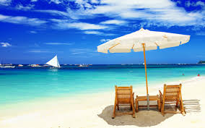
Beach Cleanup-SNHS
There will be a beach cleanup on 03/11 at Hollywood beach from 9am-12pm
It is a County sponsored beach sweep, so gloves, trashbags, etc are all provided. Don’t forget to bring water bottles, sunscreen, and some snacks !
At N Broadwalk, Hollywood, FL 33019
Sign up with Remind Events BEFORE you go to clean the beach!. You get 4 club hours.

Slide 7
Student Lectures!
We will be starting a new activity and hour earning opportunity for members. Each quarter, members can have the opportunity of giving a lecture on any new health related innovation or research discovery to obtain 3 club hours. You must make a PowerPoint presentation(10 slides in length) that teaches other club members about a new aspect of health occupations/medical innovations.
Next Lecture Date- March 28th !
4 slots available for that day!

Slide 8
Lectures
Today: William Kong/Uzair Farid on their FIU research project!
March 28th - TBA
April 18th- TBA
Guys, lectures are fun !!! Sign up to
Do them !
** Members are welcome to do lectures after getting their topics approved! It’s a great way to get hours! ☺
We changed the date to accommodate new members !

Slide 9
Science Bowl
Science Bowl has been approved for MARCH 23rd after the Early release! It is $3/person and $9 / team to sign up ! It will include physics, chem, and bio , and will be a double elimination competition like last year!
Check with your teachers to see if they’ll offer extra credit!!
Sign up with Mrs. HD ASAP! It is mandatory for those who did not compete in secme/complete all competition checks since January!
** Food is provided ( as always!)
Max of 35 teams can sign up, and it’ll be in the Cafeteria this year!!

Slide 10
Next Meeting: Next week on Tuesday for 2 MEMBER lectures/SECME schedule!!!
( Please be sure to sign up, lectures are fun, and there’s so much amazing stuff going on right now !!)

Slide 11
Any Comments,
Questions,
Or Concerns?

Slide 12
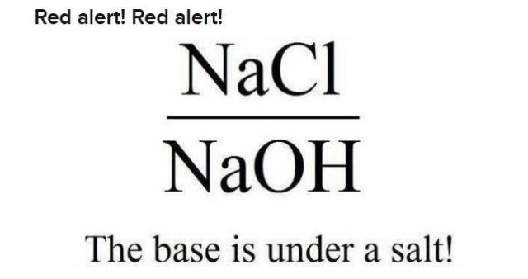
SNHS- Don’t forget to sign in!
Don’t forget to sign up for tutoring, recycling, and mark the date for the next lecture!
STAY FOR SCIENCE DAY PRACTICE!!!
Thanks!

