Slide 1
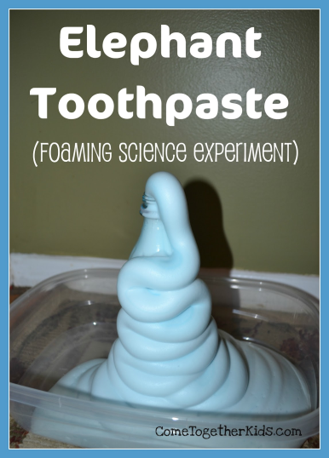
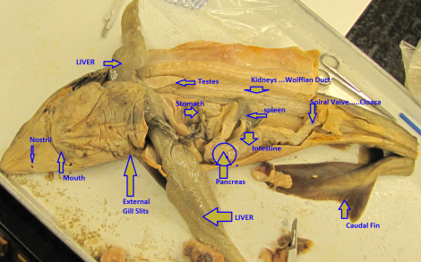
Science Days
Conduct experiments for elementary/middle school students at Charter Campuses
Academic Village
East Campus
West Campus
Science days will take place on HSSD, and each of the campuses will come to the high school to conduct science days at S building.

Slide 2
Hour Earning Opportunities
Tutoring during homeroom
Recycling- 1 hour each time you recycle
Coming to lectures- 1 hour
Coming to regular meetings- ½ hour
Attending beach cleanups- 4 hours
Practicing after school on your competitions/attending mock competitions
Attending science Days/practicing experiments

Slide 3
Upcoming events
9/21 Science Club Applications Due to room S122 by 2:00 !
Lectures 9/20 for SNHS members
Recycling every Tuesday, Wednesday, and Friday
Tutoring every Thursday during homeroom

Slide 4
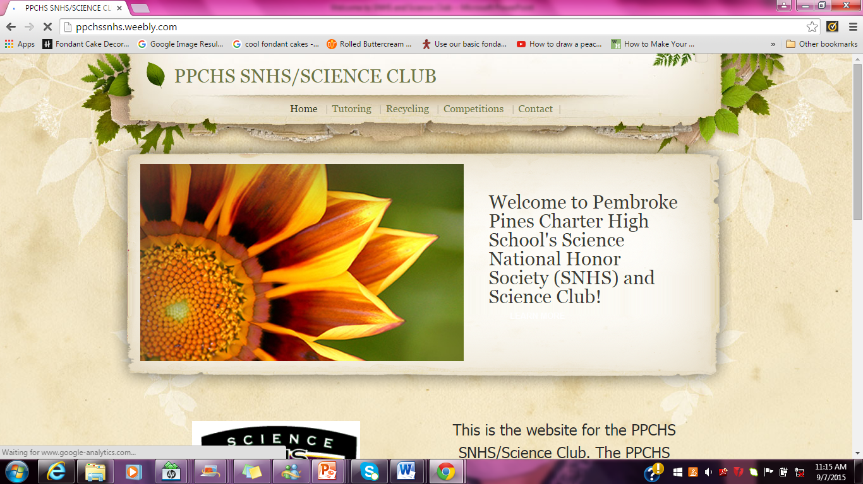
Visit our Website!

Slide 5
Donations
Balloons( Purple, yellow, white)
Gloves
Paper Towels
Mentos
2 liter soda bottles
Clorox wipes
** Parents can get hours **

Slide 6
Remind 101 Texts
Text: 81010
Message: 4acfdf

Slide 7
Any Comments,
Questions,
Or Concerns?

Slide 8
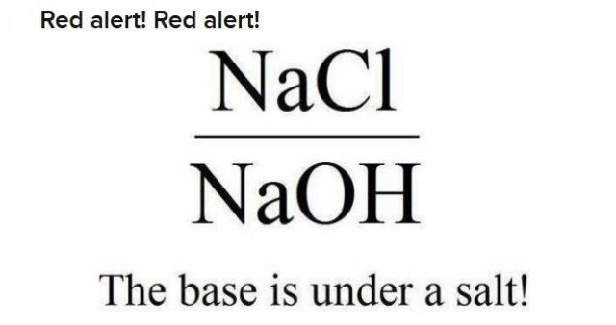
SNHS- Don’t forget to sign in!
Science Club- Don’t forget to submit your Applications on or before September 21st ! You can access them on the Website under the downloads tab.
Thanks!

